Slide 1
ADDC PBL Phase -2
Design divider circuit with 8-bit dividend and 4-bit divisor using Gold-schmidt Division Algorithm. Implement the same on FPGA and verify the functionality
Amrut R 1RV24EC025
Anurag 1RV24EC031
Bhavesh S 1RV24EC044
Mentor Name: Dr.Sujata D. Badiger
Designation: Assistant Professor
ECE Department,
RVCE, Bengaluru-560059

Slide 2
CONTENTS
INTRODUCTION
OBJECTIVES
LITERATURE REVIEW
PROBLEM STATEMENT
BREIF METHODOLOGY
IMPLEMENTATION
DESIGN OF THE GOLDSCHMIDT DIVIDER
APPLICATIONS OF THE DESIGN
RESULTS & DISCUSSION
VISUALS OF CONDUCTED SIMULATION
TECHNIQUES USED
IMPLEMENTATION ON FPGA
REFERENCES

Slide 3
INTRODUCTION
Division is slower and more complex in hardware than addition or multiplication.
Traditional methods (restoring/non-restoring) need many clock cycles (1 bit/cycle).
Project targets: fast 8-bit signed dividend ÷ 4-bit signed divisor divider.
Uses Goldschmidt algorithm for quick convergence via multiplications.
Achieves accuracy in just 4 iterations with fixed-point arithmetic.
Implemented on Pynq-Z2 FPGA using Verilog + VIO for easy testing.

Slide 4
OBJECTIVES
1: Comprehend and Adapt the Goldschmidt Division Algorithm
2: Simulate, Verify, and Deploy the Design .
3: Design and Optimize Divider Architecture on FPGA

Slide 5
LITERATURE REVIEW
Title |  | Summary | Link
FPGA Design and Implementation of Fixed-Point Fast Divider Using Goldschmidt Division Algorithm and Mitchell Multiplication Algorithm J. Yang et al. / 2024 |  | This paper proposes a parameterized Verilog-based fixed-point Goldschmidt divider integrated with Mitchell multiplication for reduced resource use. Implemented on Xilinx XC7Z020 FPGA, it achieves >99% accuracy, 99.1 ns latency (31.7 ns faster than baselines), and 46.68% fewer slice registers vs. Vedic multiplier variants—ideal for scalable, low-resource FPGA systems | https://arxiv.org/abs/2508.14611
Design and Synthesis of Goldschmidt Algorithm Based Floating Point Divider on FPGA S. Das et al. / 2016 |  | Describes a 32-bit single-precision floating-point Goldschmidt divider using Vedic (Urdhva-tiryakbhyam) multipliers and subtractors for mantissa computation. Synthesized on Xilinx Spartan-6 FPGA, it offers low latency, high accuracy, and optimal cost-performance trade-offs, with RTL details suitable for adapting to smaller fixed-point widths. | https://ieeexplore.ieee.org/document/7754360

Slide 6
LITERATURE REVIEW
Title |  | Summary | Link
Hardware Divider Based on Goldschmidt Algorithm for FPGA Implementation O. Bureneva & A. Pavlov / 2025 |  | Introduces a fixed-point Goldschmidt variant eliminating argument scaling, using iterative calculations in hardware. FPGA-tested for efficiency, it reduces complexity for embedded designs; includes synthesis results and comparisons showing lower latency/area vs. traditional methods—directly applicable for 8/4-bit optimizations. | https://ieeexplore.ieee.org/document/11060219
Implementation of Goldschmidt's Algorithm with Hardware Reduction T. D. Roy / 2019 |  | Analyzes the Goldschmidt block diagram for floating-point division and proposes path optimizations to cut latency and cost in FPGA/ASICs. Demonstrates hardware reductions via alternative computation paths, with error analysis and RTL suggestions; achieves better efficiency for iterative multipliers in resource-constrained environments | https://arxiv.org/abs/1909.10154

Slide 7
PROBLEM STATEMENT
Division in hardware is slower and more complex than addition/multiplication.
Traditional methods (restoring/non-restoring) need many cycles (1+ per bit), causing high latency for 8-bit operands.
Designing a signed 8-bit dividend ÷ 4-bit divisor divider is challenging (signs, normalization, rounding, divide-by-zero).
Slow algorithms limit FPGA performance where speed and parallelism are key.
This project uses Goldschmidt algorithm for fast convergence, Verilog implementation on Pynq-Z2, and VIO verification.

Slide 8
BREIF METHODOLOGY
Start with binary input analysis and choose a suitable fixed-point format
Normalize the divisor using left shifts so it falls within 0.5–1 range
Generate the initial reciprocal approximation for the normalized divisor
Perform Goldschmidt iterations:
Compute correction factor
Multiply both dividend and divisor in parallel
Store intermediate values using registers and pipeline stages
Convert refined dividend value into final quotient representation
Test division accuracy using simulation waveforms
Deploy the design on FPGA and verify using hardware inputs/outputs

Slide 9
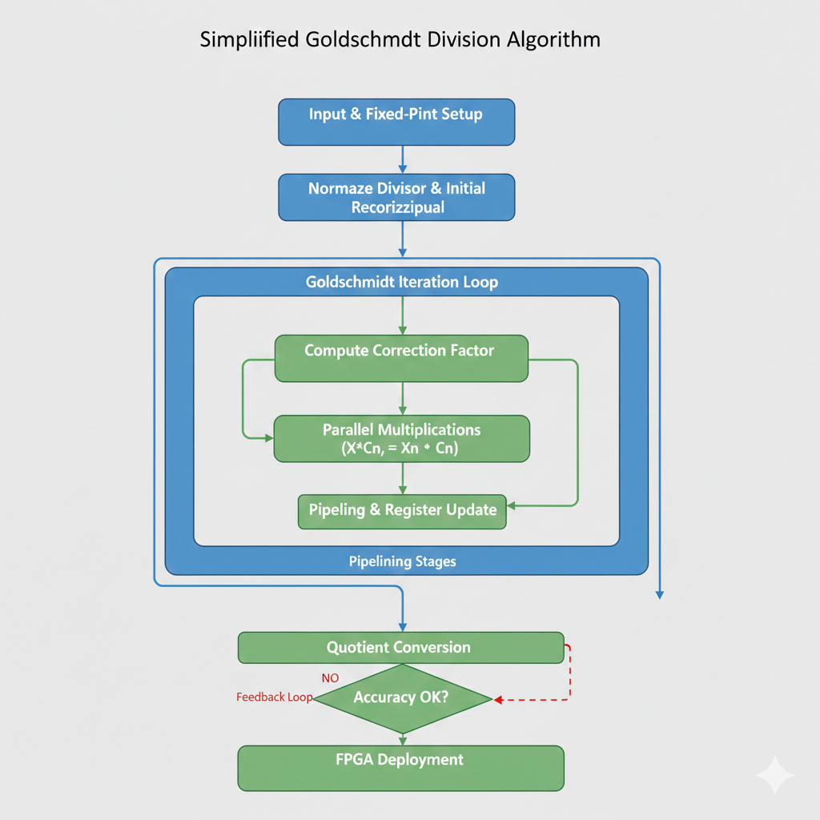
BREIF METHODOLOGY
Fig 1:

Slide 10
IMPLEMENTATION
Designed 8-bit dividend and 4-bit divisor in fixed-point binary format
Normalized divisor through controlled left-shifting
Built Goldschmidt iteration block:
Computes correction factor
Performs parallel multiplications using DSP slices
Wrote RTL in Verilog and simulated using Vivado
Synthesized and implemented on FPGA (PYNQ/ZYNQ)
Used VIO to implement 8-bit dividend and 4-bit divisor on FPGA
Verified quotient output .

Slide 11
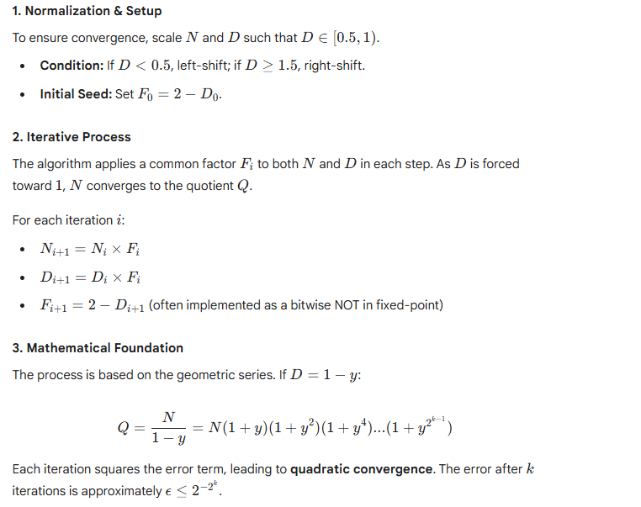
DESIGN
1

Slide 12
DESIGN
The core module gsda is a finite state machine (FSM) with 5 states:
State 0: Handle signs and absolute values.
State 1: Load to 16.16 fixed-point (N = dividend << 16, D = divisor << 16).
State 2: Normalize D to [0x8000, 0xFFFF].
State 3: Compute F = 0x20000 - D.
State 4: Update N and D via multiplications, loop for 4 iterations.
Final quotient: Rounded from N[23:16] + N[15] (for 0.5 rounding), with sign applied.

Slide 13
APPLICATIONS OF THE DESIGN
High-speed division units in CPUs, GPUs, and DSP processors.
Floating-point arithmetic units that require fast, parallel division.
Signal processing systems (FFT, filters, communication modems).
Real-time embedded systems where iterative subtraction (long division) is too slow.
Graphics and gaming hardware for quick coordinate and pixel calculations.
Machine learning accelerators needing rapid normalization and scaling.
FPGA-based controllers performing fast ratio calculations and control loops.

Slide 14
RESULTS & DISCUSSION
Correct quotient for any 8-bit dividend ÷ 4-bit divisor
Stable and accurate results after a few Goldschmidt iterations
Reduced error with each iteration due to multiplicative refinement
FPGA implementation showing real-time output in VIO
Simulation waveforms confirming correct normalization and convergence
Efficient use of FPGA resources

Slide 15
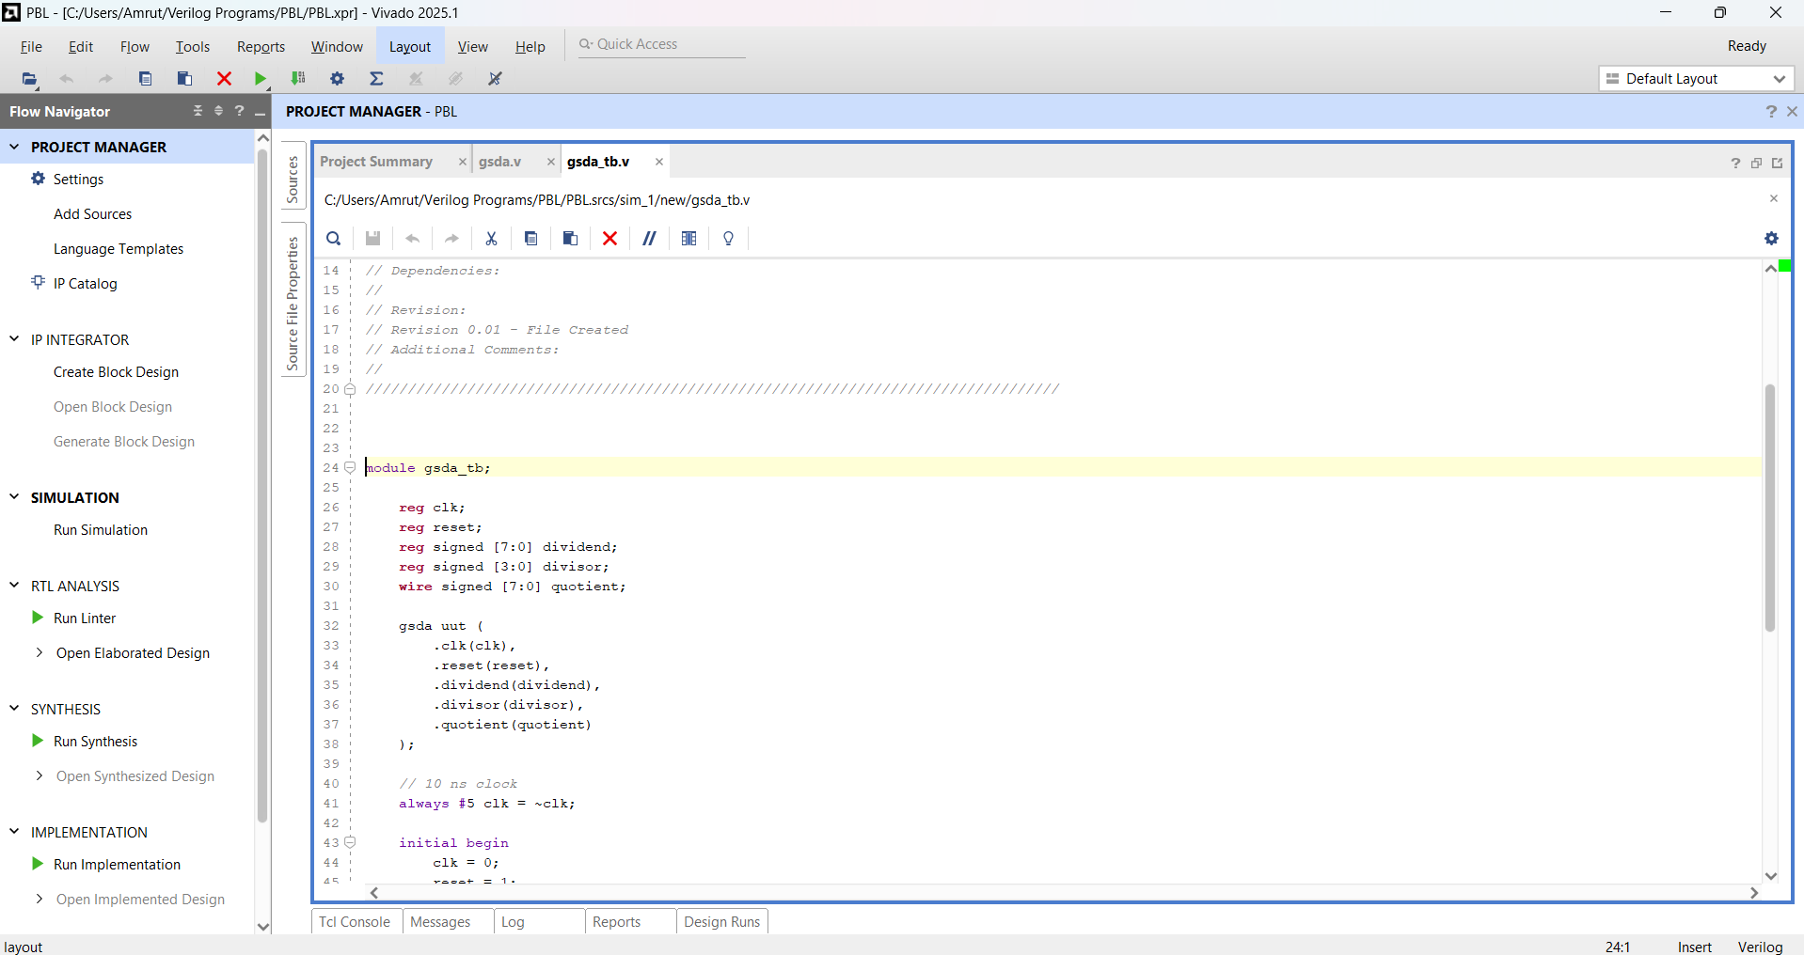
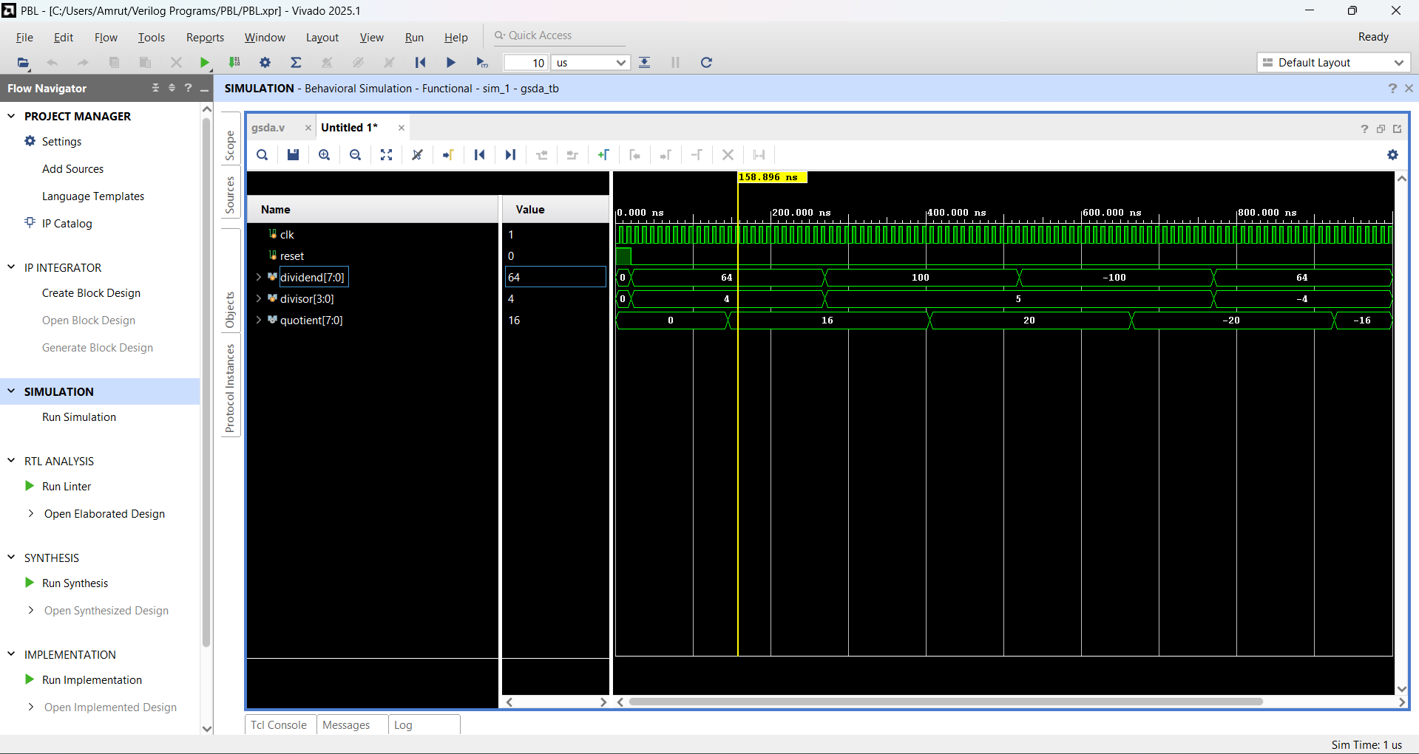
VISUALS OF CONDUCTED SIMULATION
Fig 2: Test Bench

Slide 16
VISUALS OF CONDUCTED SIMULATION
Fig 3: Output Graph

Slide 17
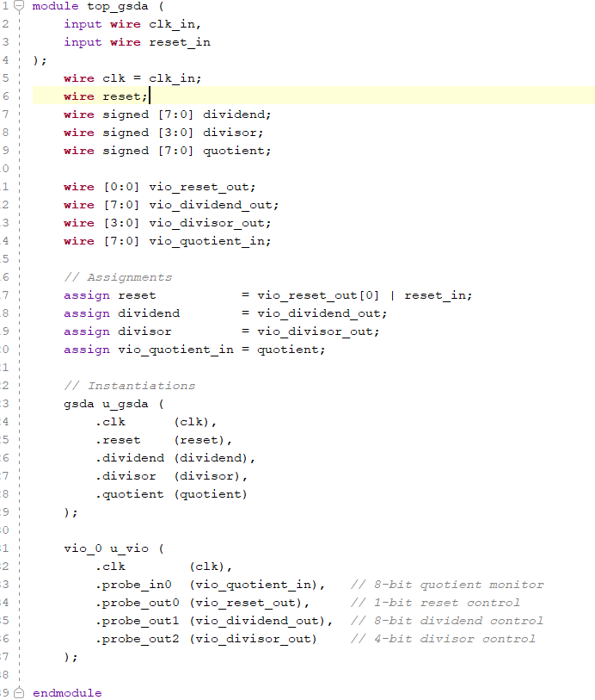
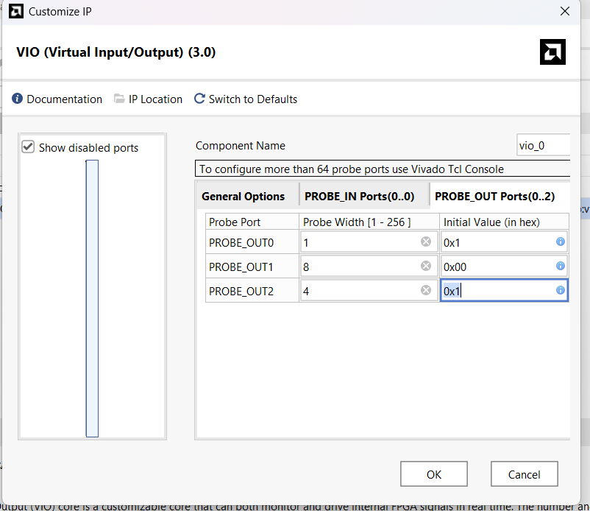
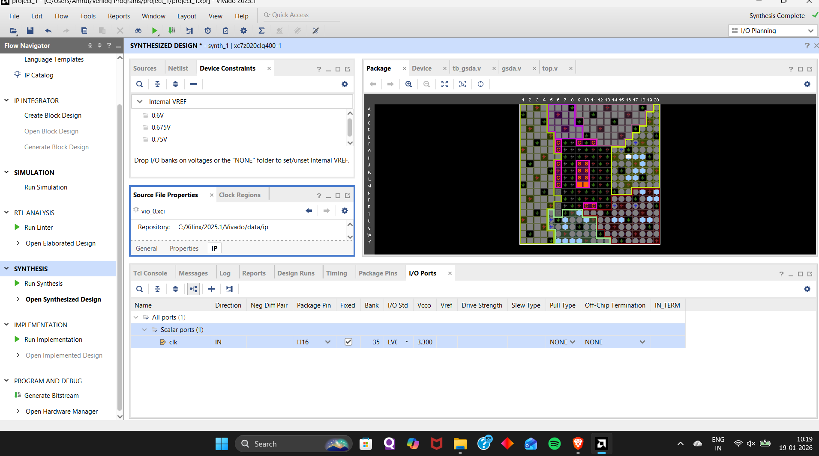
TECHNIQUES USED
Fig 4:
Running Synthesis
Fig 5: Specifying VIO ports Through IP Catalog to implement the dividend and divisor
Fig 6: Module instantiating both main module and Vio

Slide 18
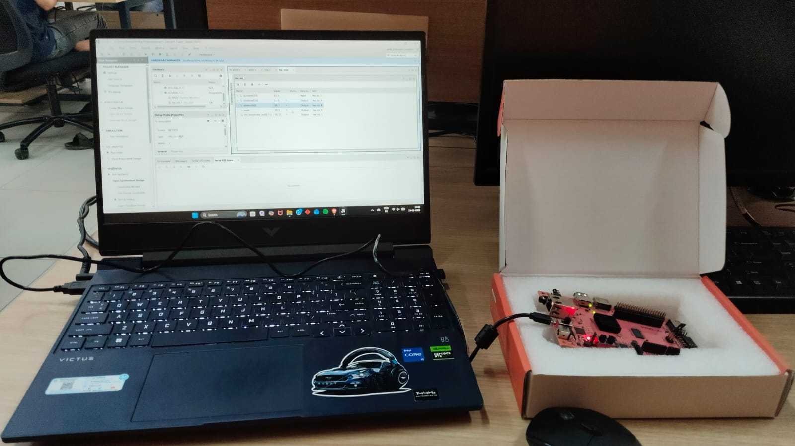
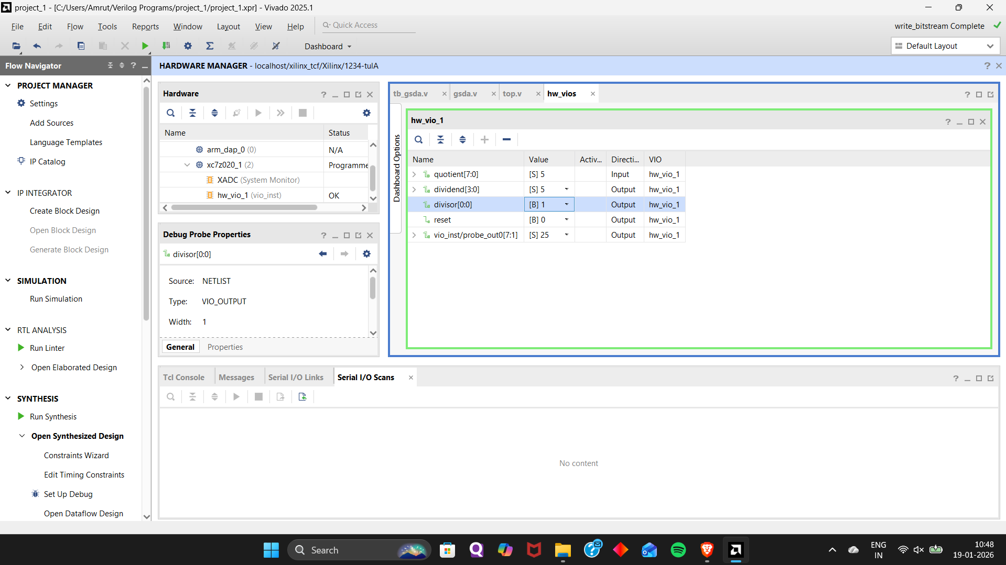
IMPLEMENTATION ON FPGA
Fig 7: Implementation of the required Verilog code into FPGA ( PYNQ Z2 )
Fig 8 : Verification of results

Slide 19
REFERENCES
FPGA Design and Implementation of Fixed-Point Fast Divider Using Goldschmidt Division Algorithm and Mitchell Multiplication Algorithm, J. Yang et al. / 2024
Design and Synthesis of Goldschmidt Algorithm Based Floating Point Divider on FPGA ,S. Das et al. / 2016
Hardware Divider Based on Goldschmidt Algorithm for FPGA Implementation O. Bureneva & A. Pavlov / 2025
Implementation of Goldschmidt's Algorithm with Hardware Reduction,T. D. Roy / 2019
Singh, R., et al. (2016). Design of Goldschmidt-Based Floating-Point Divider on FPGA. IEEE.

Slide 20
THANK YOU

